Slide 1

VII Secretum
Created by 7 Sins
Notes:
Presentation Speakers:
Apostolos (General - Workflow)
Thanasis (History, Magic & Science)
Kiril, Damian (Notable Persons)
Damian (Types of Magic)
Thomas (Magic in Teaching)
Layout - Menu (Damian)

Slide 2
VII Secretum
What is it?

Slide 3

Workflow/Preparation
Notes:
A few things on how our team has been working.

Slide 4

Work Progression
Decided how we will work
Creation of site map
Creation of the basic html files
Designing the layout
Notes:
I am finishing the intro part here~
Let’s make a photo of us at work and put it here!

Slide 5
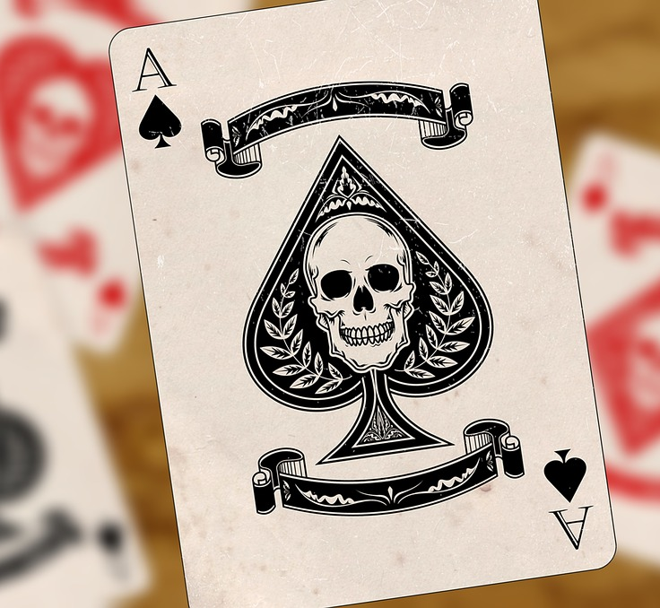
About
History of Magic
Famous Magicians
Types of Magic
Magic in Science/Teaching
Notes:
Summary of what the site is about.

Slide 6

History
Timeline
Antiquity
1500 to 1900
1900 to today
I also connected the pages with a menu.

Slide 7
This is how it looks

Slide 8
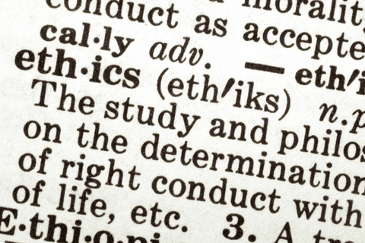
Ethics
Classic Ethics
Work Ethics
Online Ethics

Slide 9
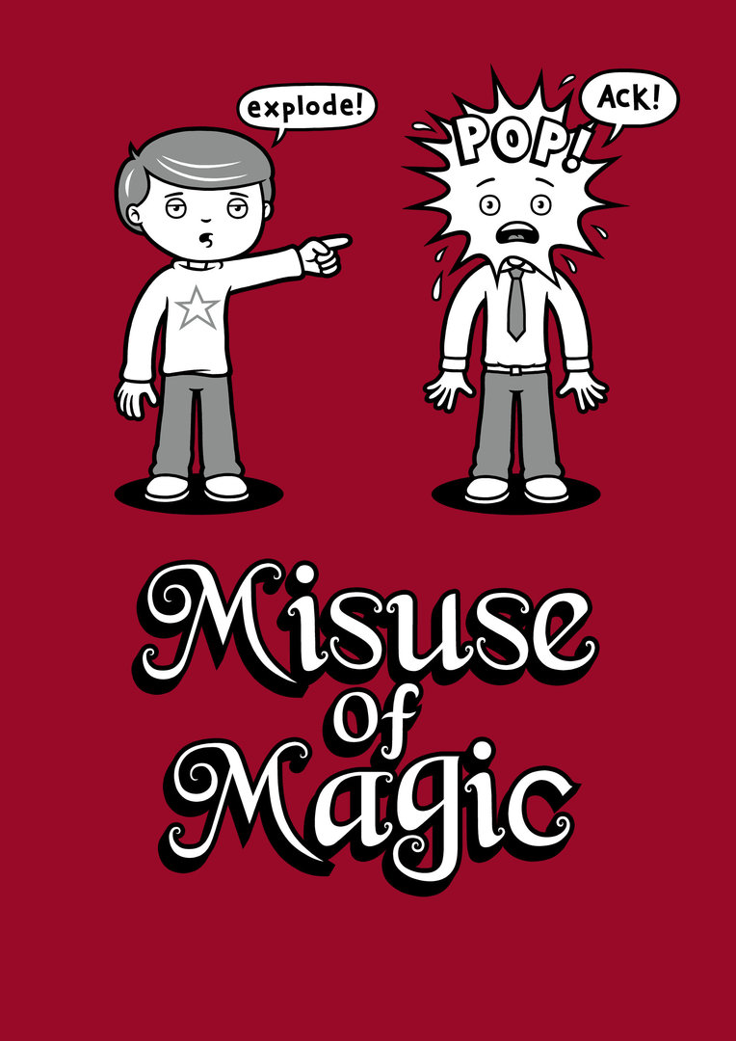

Slide 10
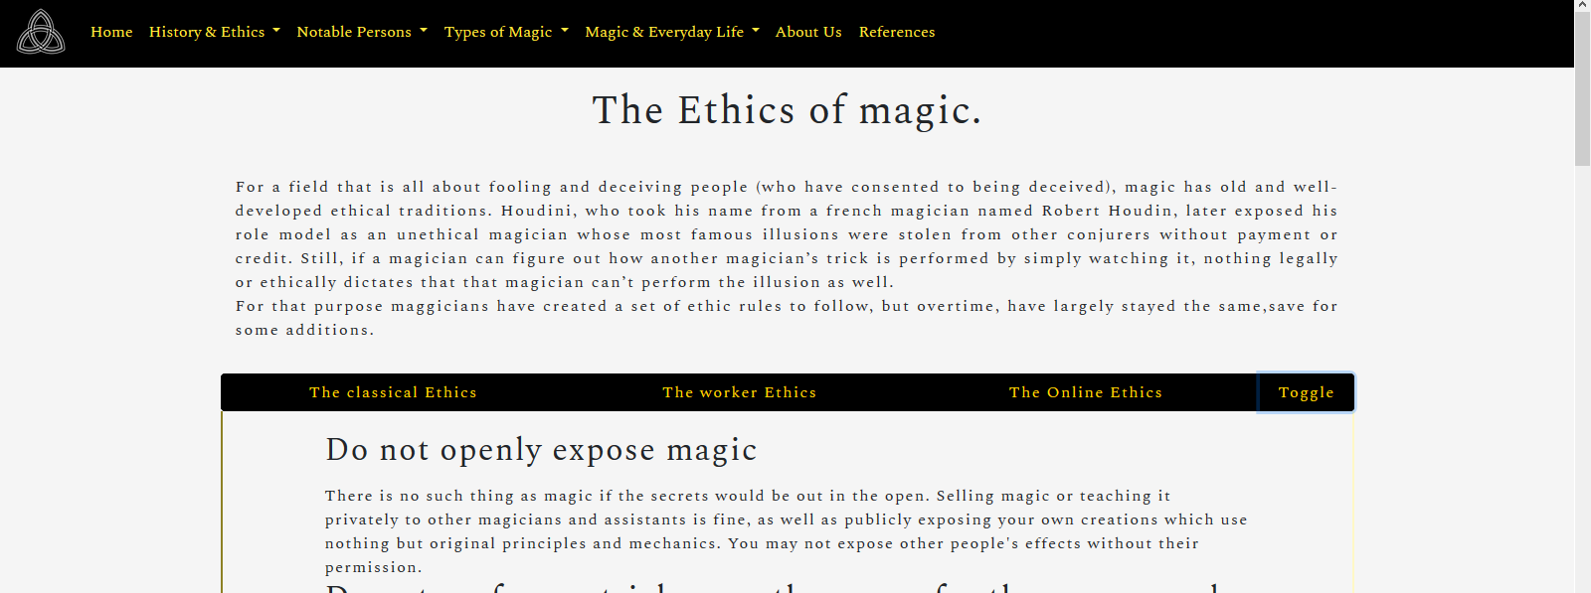
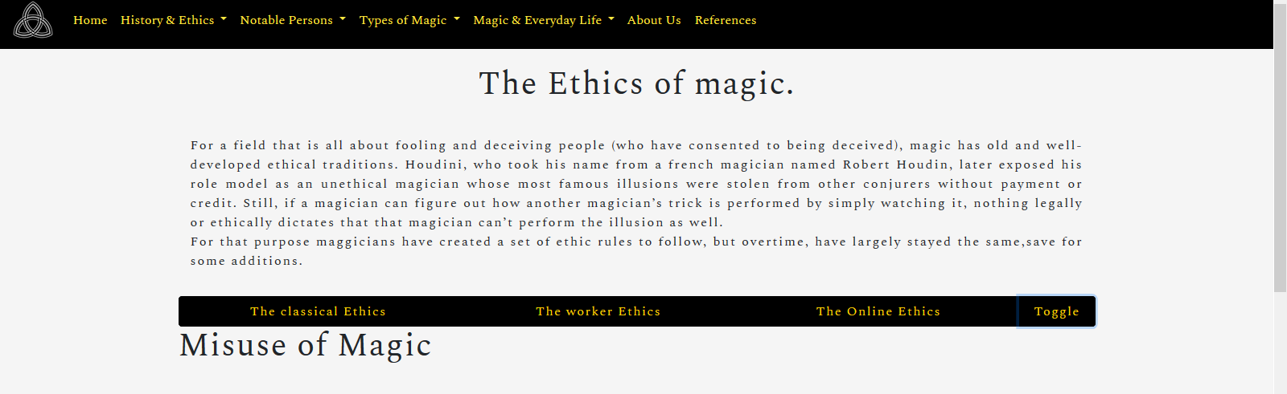
Iframe toggle
In the Ethics pg i also added a toggle button for the iframe used to display the different types of ethics

Slide 11
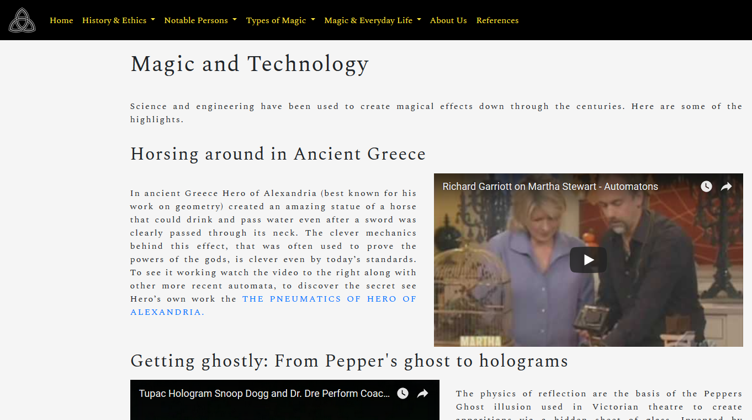
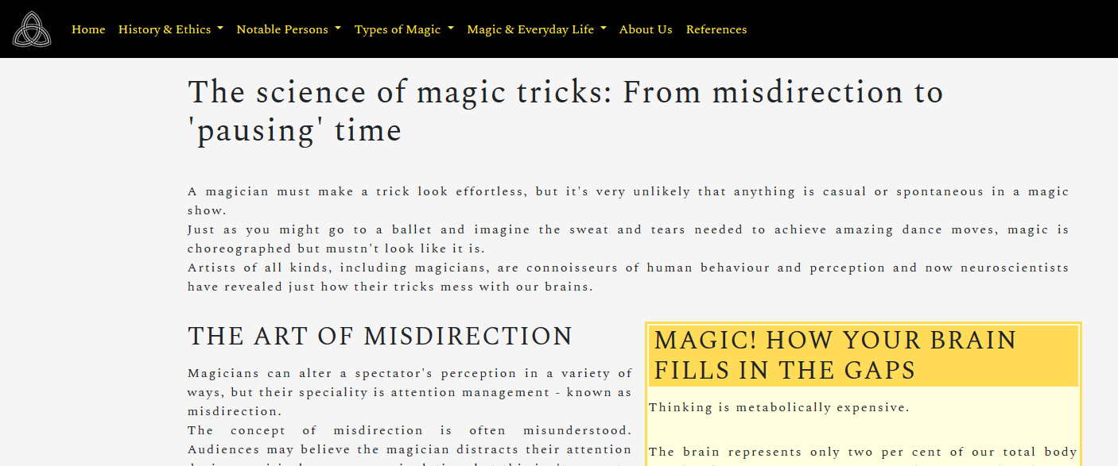
Magic and Science
Magic and Technology
Magic and neurology

Slide 12
Layout Design
Workarounds & Implementation
Notes:
Hello dear classmates, I will present you how the site was developed

Slide 13





Technologies
We used the latest and most trusted components currently used in web development.
Notes:
First lets talk about the technologies used. Totally 5 technologies were used to develop the site. The site was done accordingly to the HTML5 Standards, and with the help of CSS3, JS5 and Bootstrap 4.

Slide 14
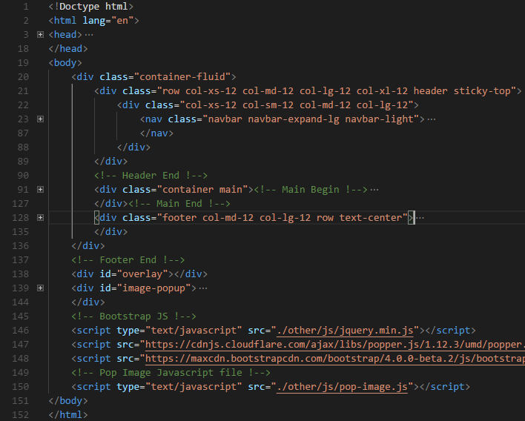
Layout Structure
Header - 100% wide
Main - 80% wide
Footer - 100% wide
‘Magazine Layout’
Notes:
Some words for the layout.... For easier maintenance and better workflow the layout was divided into 3 parts: Header, Main and Footer. All of the them were nested into a bootstrap div with a class of ‘container-fluid’. The target was to create a Magazine layout. So the header and the footer were 100 percent wide while the main was 80 percent wide. Using this technique had as a result the main content to look thinner than the rest of the page.

Slide 15

Bootstrap
As we all know designing websites with Bootstrap is 10x faster than usual.
Especially with the version 4.0 - beta.2 which we used.
Notes:
Now lets see how much useful the Bootstrap Framework is. At first, I designed the layout in just HTML. Later I redesigned the layout in Bootstrap version 4. Then the big difference of designing websites with and without Bootstrap came clear to me, as the Bootstrap site was developed in almost 5 hours instead of 10, just 50 percent of the time!

Slide 16
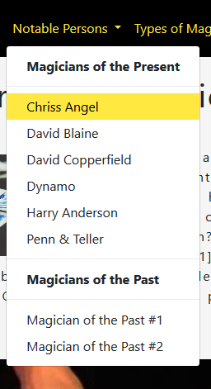
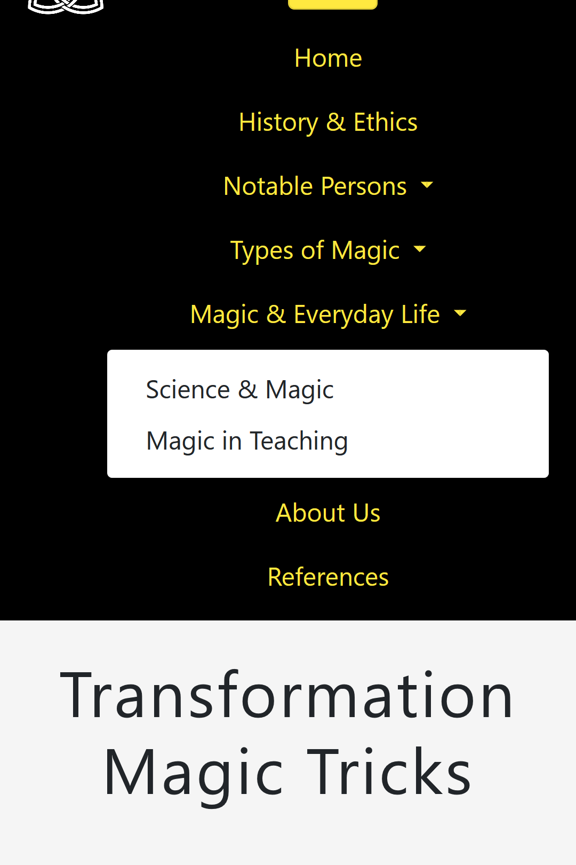
Header Structure
Navbar Responsive - .navbar-expand-lg
Navbar Brand - .navbar-brand
Navbar Dropdown .navbar-item.dropdown
Notes:
Lets continue with the header structure. I used a navbar to implement the menu, and added to it a class of ‘navbar-expand-lg’ to achieve responsive behavior. I also inserted a navbar-brand to nest the logo. Last but not least, I used navbar items with a class of ‘dropdown’ to include more menu links.

Slide 17
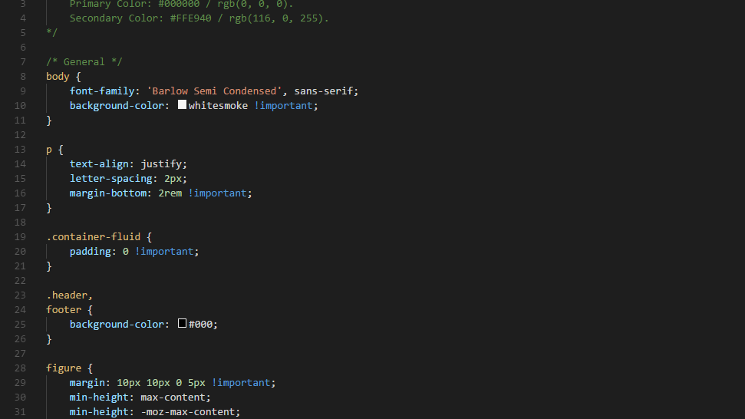
CSS
layout.css
responsive.css
Notes:
As for the CSS code it was divided into 2 external CSS files: the layout and the responsive. The layout includes almost all the code of the site. The responsive includes all the responsive code, written with media queries for each one of the Bootstrap breakpoints.

Slide 18
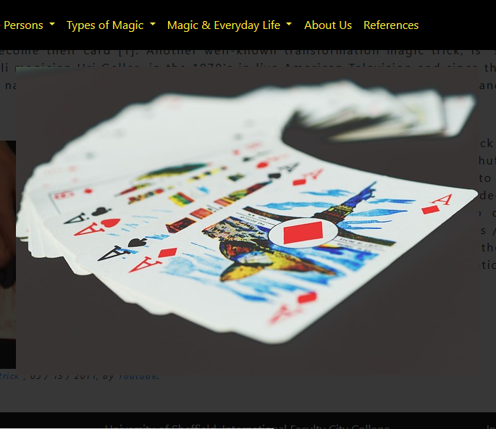
Javascript
Image Popup made with Jquery:
Notes:
Finally to make the site dynamic, I wrote in JQuery a custom Image Popup module. The module magnified the selected image, while making the rest of the page seem faded. The Popup then closed when the user clicked outside the image, or when the user pressed the Escape key.

Slide 19

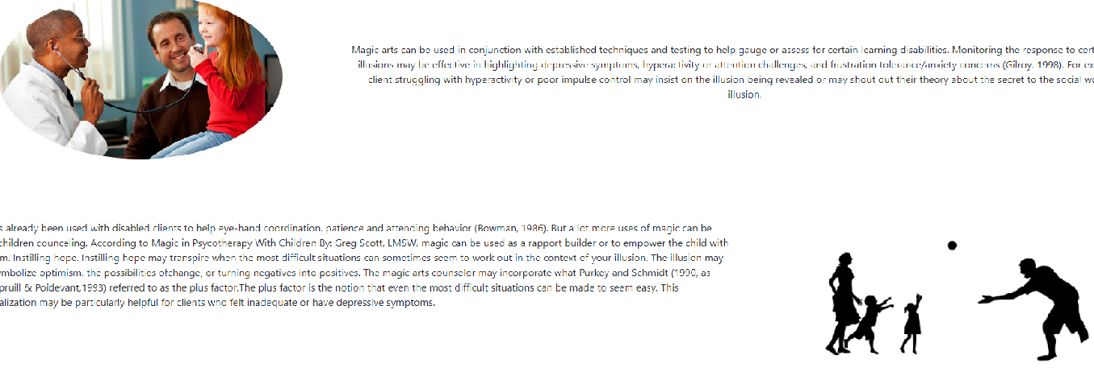
Magic Applications in everyday life
Magic and Disordered People
History of magic on the field.
Magic in children counseling
Notes:
Magic is a multi aspected art and in everyday life its value can be much greater than entertainment. In this part of the website i focused on its use with disordered people and children counseling. Information on how magic was used on these fields and ... how it can be useful for the practitioners out there is provided together with some friendly images appropriate for each paragraph.

Slide 20
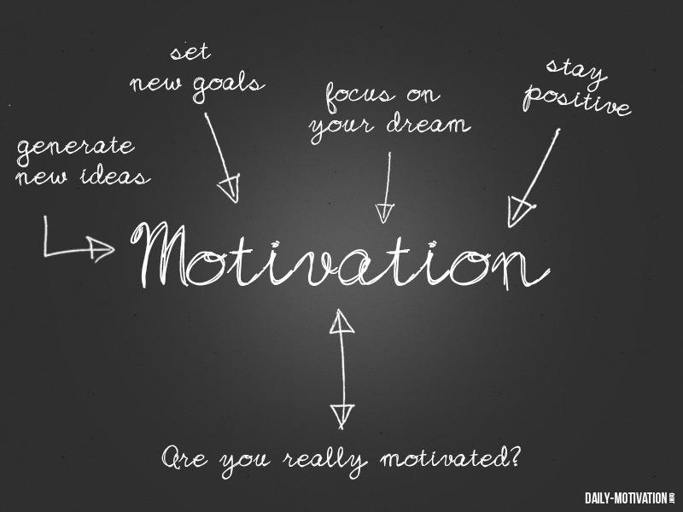
Flames of motivation can be sparked by magic
A video depicting how it can be done
Notes:
Motivation and magic are a bit of an open subject. But we CAN be motivated by magic. First we need to define what is motivation for us though. And to do that for the viewer i added an explanation of a motivated person with an image representing the need that drives him. Also a small homemade way a class can be motivated by a teacher is a available through a video.I thought the content should not be just theoretical.

Slide 21
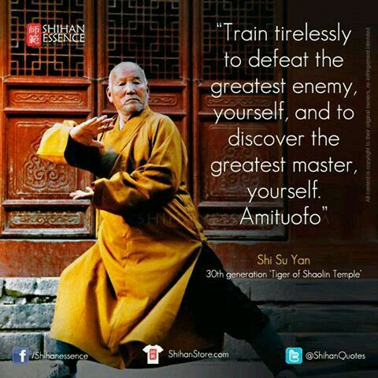
Persistence through magic
The site focused on asian culture to depict
the internal struggle.
A small clickable trick was added to attract
the user during his stay.
Notes:
Persistence through magic . And what would be more attractive to a youth audience other than shaolin warriors. In asian culture and specifically that of the shaolin … discipline and persistence are honed and are required to advance. If i could persuade the user to link his enthusiasm of the warriors with magic and show that persistence can be honed the same way for a magician i add credit to the facts and at the same time keep him from getting bored of the philosophical meaning. Thats the second part of the page.

Slide 22
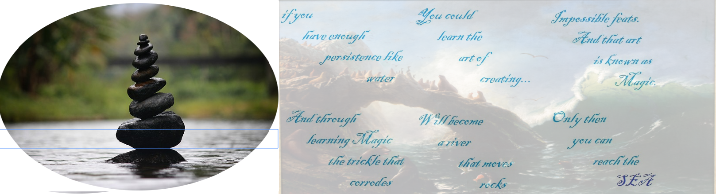
The small game attracts the user and keeps his attention while dealing with philosophy
It is Simple and easy and adds to the appearance of the site
Notes:
The first part is a game.This small clicking game depicts how water flows and corrodes these stones. The user after the explanation provided in a small paragraph … clicks on each level or stone and a small saying appears on the right image, inside an iframe. The philosophy displayed is a mixture of ancient sayings about water and persistence linked to the art of magic. Lastly after this two paragraphs explain what is required to build skills as a magician and how that boosts willpower to persist through daily life.

Slide 23
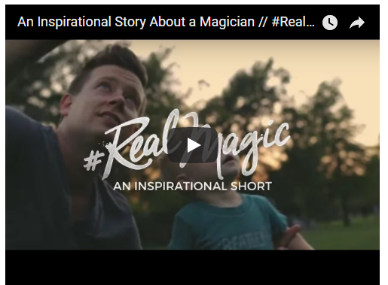
Principles through magic and illusion
A video heavy site
Relaxing theme to counter the strict aspect of “principles”
Few explanatory words
Notes:
This site is video heavy because of the relevance found on these videos as they explicitly have to do with principles and magic in action … as well as an emotional story of a true magician.

Slide 24
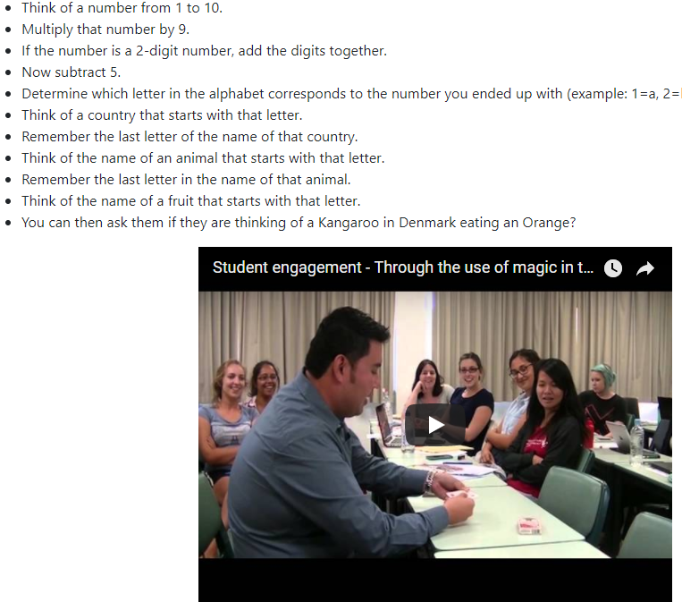
Teaching through magic
Short explanation of how magic in teaching could work
An actual method a teacher could use
Practical usage of magic in teaching shown in a video
Notes:
Teaching and magic are focused on teachers that have to do with our youth audience. Magic can become a fun and productive way of learning and this exactly is what is explained in this website. Because teachers have alot in their mind a practical method to use magic in teaching is presented as well as a video with a teacher using magic not to motivate this time but to explain a subject.

Slide 25
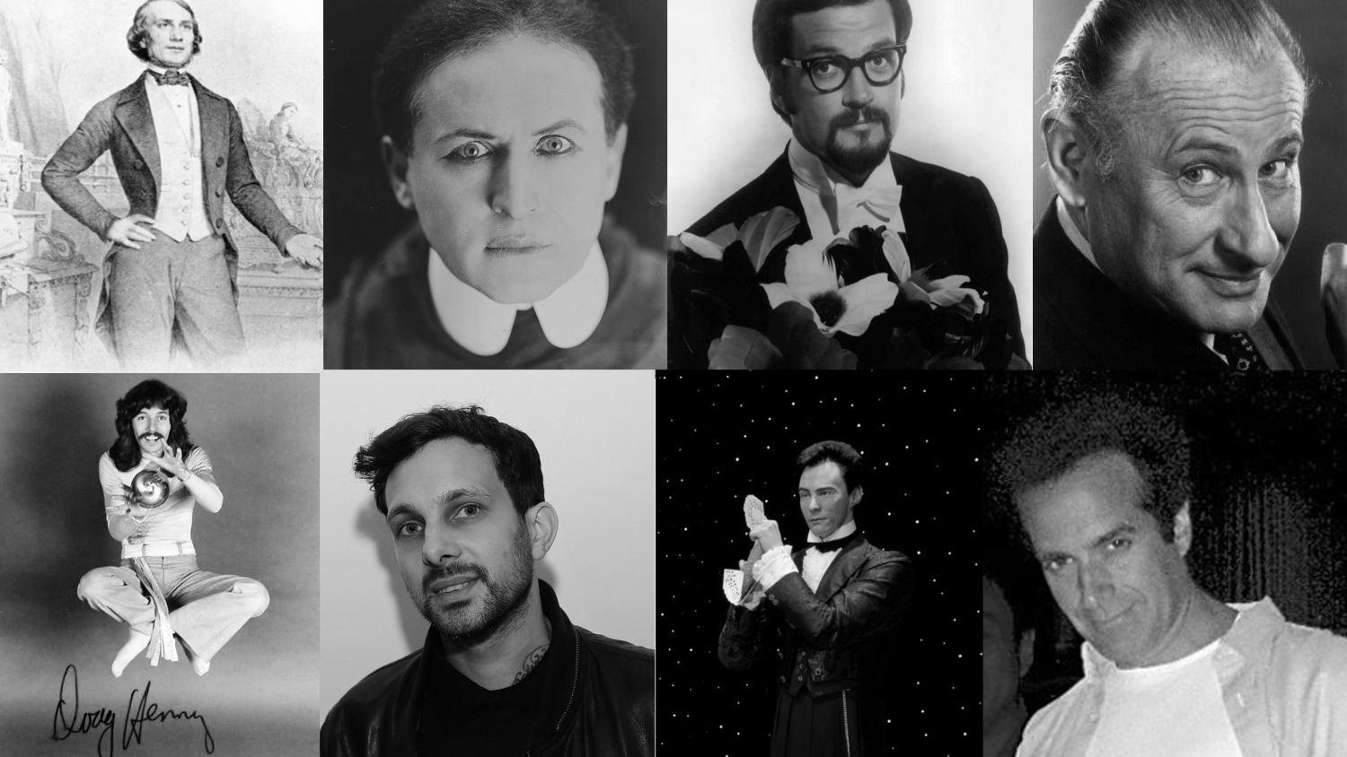
Notable Magicians
-
Biographies
Notes:
Magicians of the past, magicians of today - this whole section of the website is dedicated to the biographies of the most impressive and outstanding magicians.

Slide 26
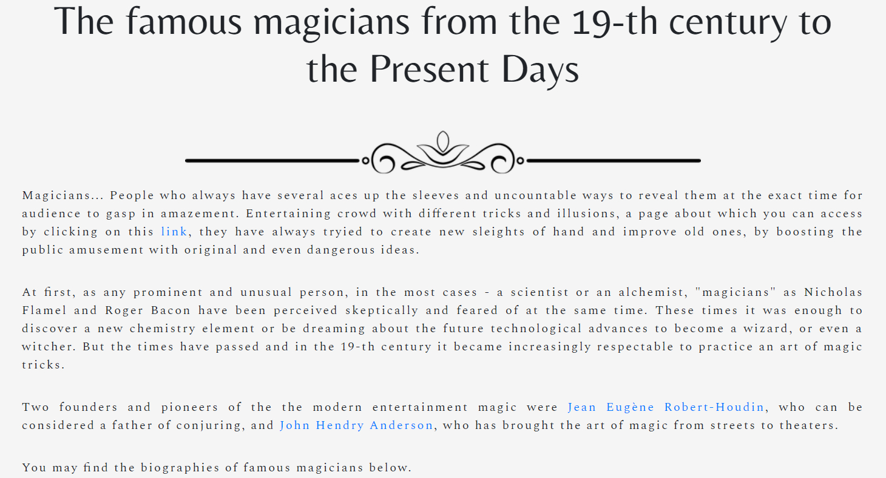
Main Catalog
Notes:
All the books have something in common: they all have a TOC and a prehistory. While first awaits us on the future slides - the prehistory part is in front of you. By the way, my credo is - I do things for the results, not for the fancy emptiness.

Slide 27
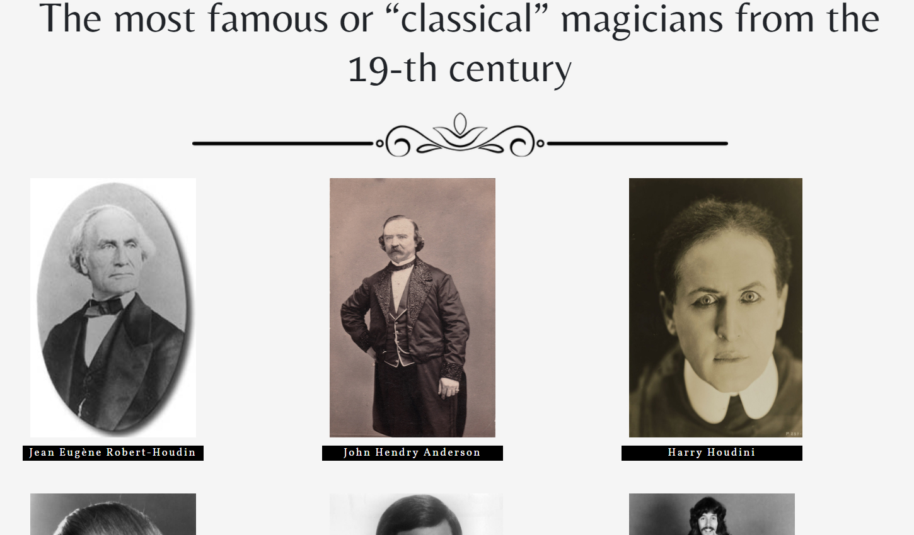
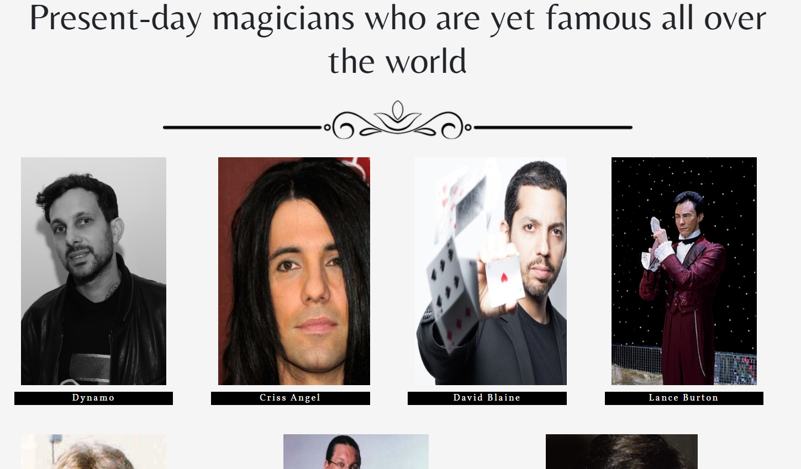
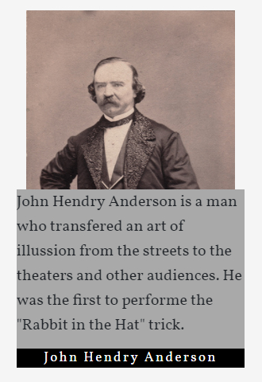
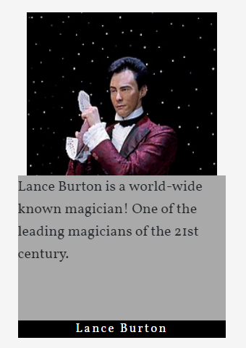

Two time periods
A short description appears on hover
Notes:
The library of the biographies consists of 13 biographies: 6 famous virtuoso-magicians, who have already passed away and 7 who are still guiding us throw an amazing world of magic with their magnificent illusions. When hovering on the magician’s portrait, a small description of the person appears.

Slide 28
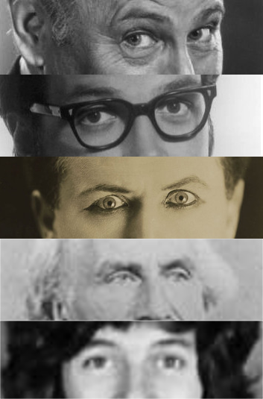
Magicians of the Past
Jean Eugène Robert-Houdin
John Henry Anderson
Harry Houdini
Carl Ballantine
Harry Blackstone Jr
Doug Henning
Notes:
This part - the magicians of the past, consists of the following personalities. Particularly these folks made the world of magic as it is today.

Slide 29
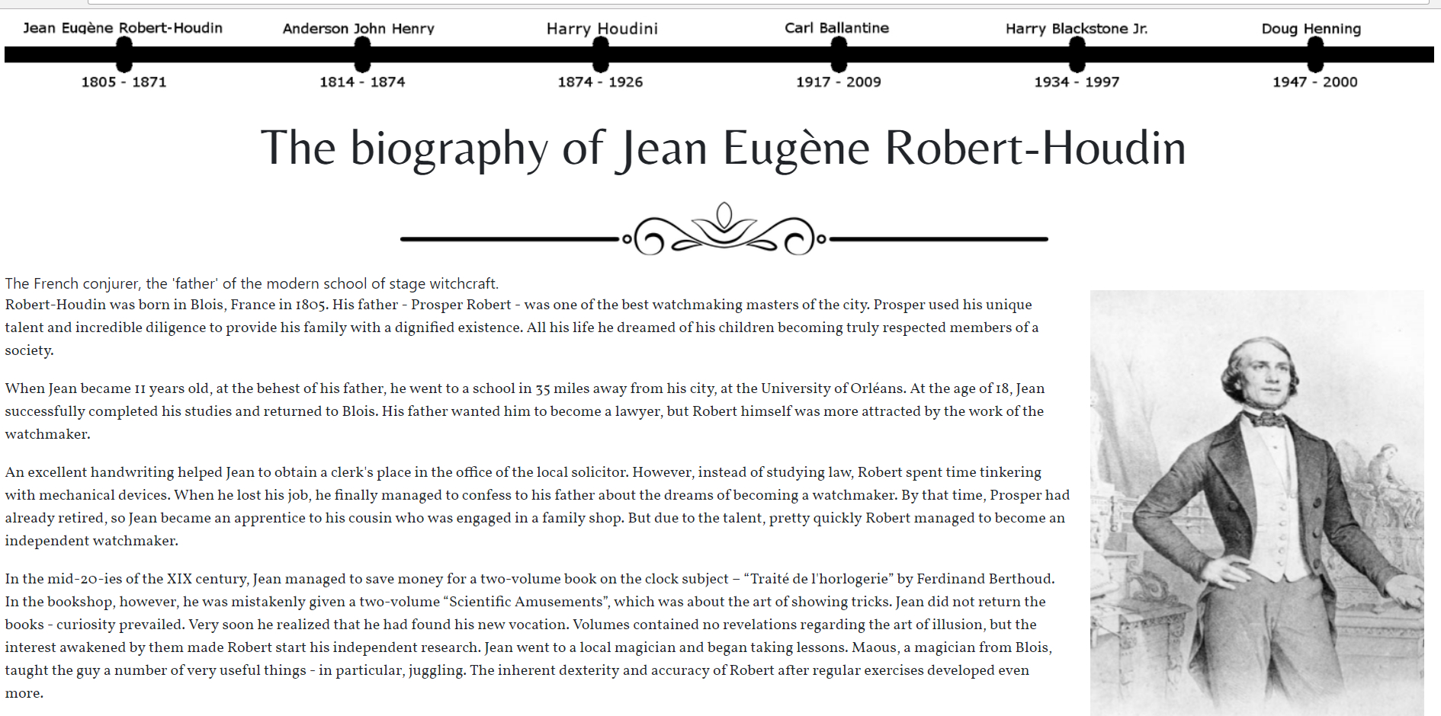
A sample of a biography page
Notes:
This is how all of biographies are. I mean style, not the content:) All the texts from the “Magicians of the Past” were rewritten by me, not to be accused of copyright violation.

Slide 30
Timeline Explained
All buttons are hover-interactive
Notes:
This is the timeline. It helps the user to quickly navigate through the whole section without returning to the catalogue page. As you can see, it has a pretty animation when hovering over the buttons. However, there was an issue with it - I could not make the page’s width 80%, because it became broken.

Slide 31
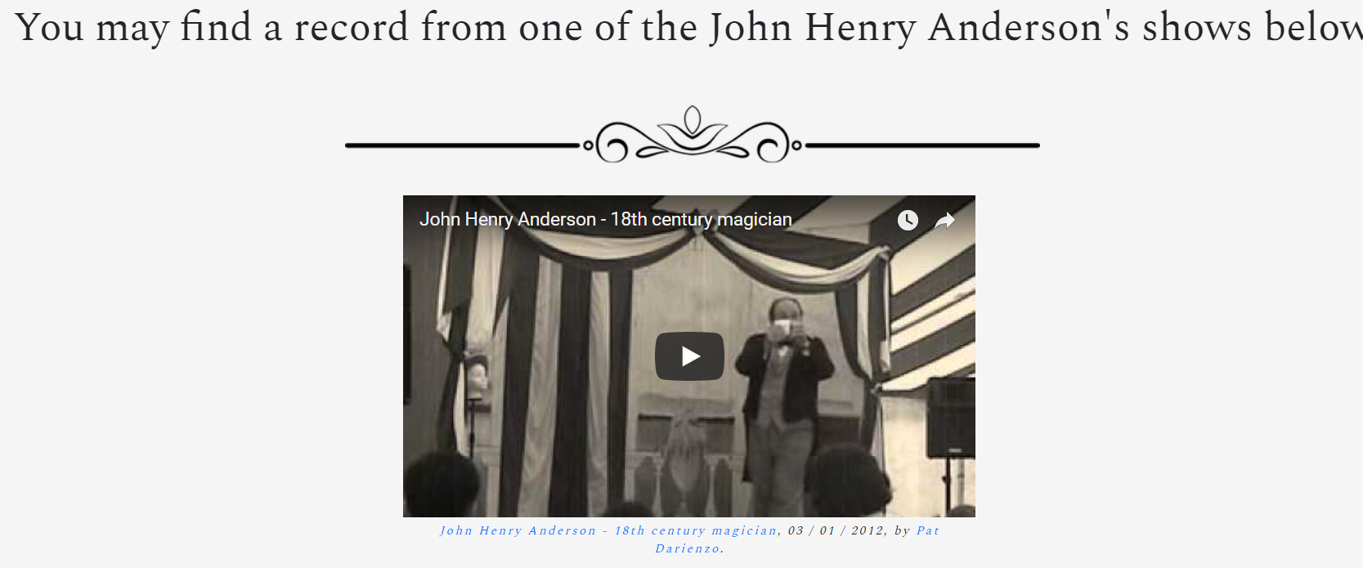
Let the show begin!
A video is included at the bottom of the biography pages
Notes:
Let the show begin! At every, except for one pages you can watch the videos related to the person’s described.

Slide 32

I am not a superman...
You have found a mistake in the text or want to edit the outdated information?
Click on the link for a word download with all info
Notes:
Yeah, we all make mistakes. We are not machines. I am almost 99% sure that something is amiss in my biographies, so I am open for any suggestions on the subject of issues or outdated information. For convenience, I have attached a Word document, which can be downloaded from the following link.

Slide 33
Magicians of the Present
Chriss Angel
David Blaine
David Copperfield
Dynamo
Lance Burton
Harry Anderson
Penn & Teller
Notes:
Hello again! In these pages, I included the biographies of the most well known magicians of our time. Lets name them. The greek Chriss Angel ‘Sarantakos’, David Blaine. Who doesnt know David Copperfield? The British phenomenon Dynamo. Lance Burton, Harry Anderson. The famous duo Penn and Teller. All of them have made history in the art of magic.

Slide 34
Types of Magic Tricks

Slide 35

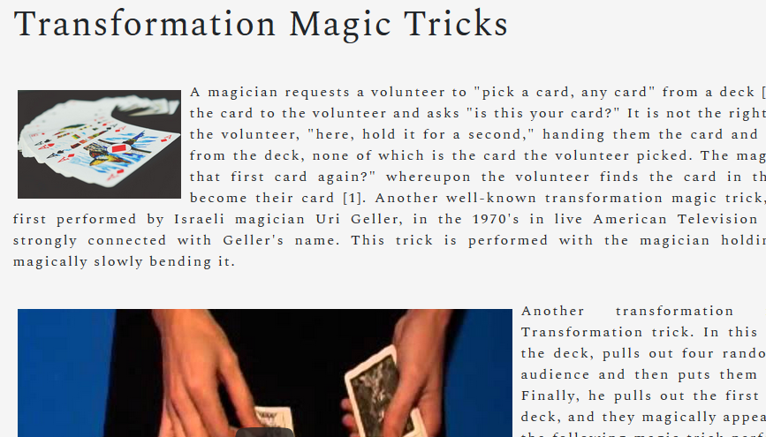
Transformation Magic Tricks
Images
Videos
Explanatory words
"Magic tricks" or "effects", or "illusions" are illusions of impossible, or supernatural accomplishments which are created by using purely natural means, in order to entertain an audience.
Notes:
Transformation Magic Tricks, “Magic tricks” or “effects” …. In this page I included a few images, some videos and a few explanatory words which contained some examples of transformation tricks, and how they distinct from the rest of the magic tricks.

Slide 36
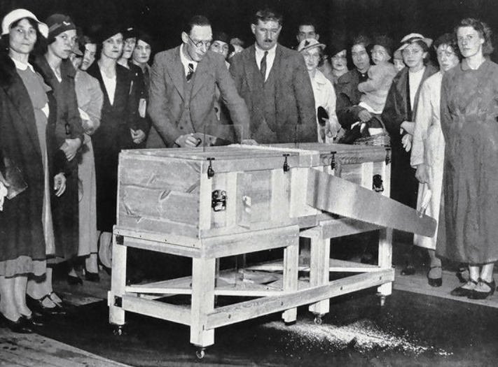
Restoration Magic Tricks
Sawing Woman Trick
Geller’s Bended Spoon Trick
"Restoration" magic tricks, put something back into the state it once was.
Notes:
Restoration Magic Tricks. Restoration Magic Tricks… This page includes a few examples of Restoration Magic Tricks such as the notorious ‘Sawing Woman’ trick and the famous Uri Geller’s ‘Bended Spoon’ trick.

Slide 37
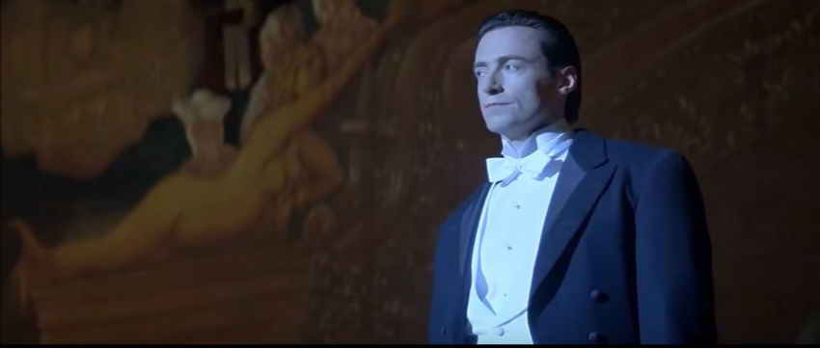
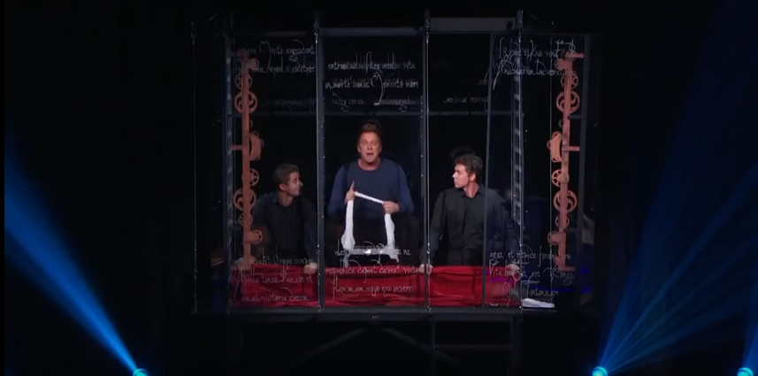
Teleportation Magic Tricks
Video
Notes:
Just like Hugh Jackman in ‘The Prestige’ teleported himself from the stage to the back of the theatre, I included a video of a magician performing a Teleportation trick on stage.

Slide 38
Other types of magic tricks
Vanishing tricks
Levitation tricks
Penetration tricks
Production tricks
Mentalism tricks

Slide 39
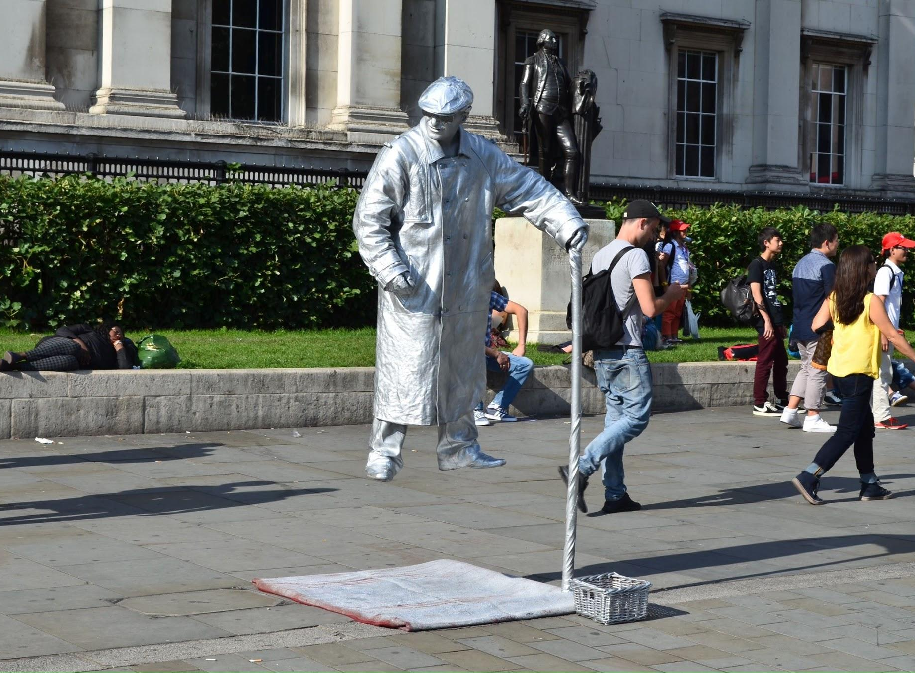
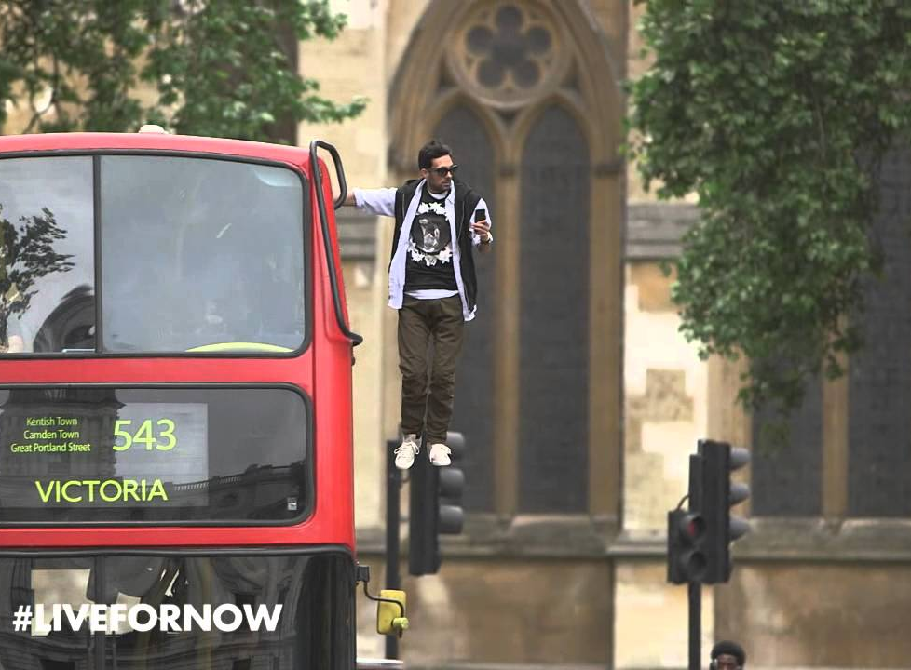
Levitation tricks

Slide 40
Thank you!
7 Sins

